Slide 1

Pre-approving Loans
Target Audience: Loan Approval Team
Stephan Grimm
17.07.2020

Slide 2
Table of Contents
Overview
Dataset
Model
Summary

Slide 3
Can we pre-approve loans?
Objective
Automate loan approval process
Model to pre-approve existing customers
Questions to be answered:
Which factors determine the approval for each customer?

Slide 4
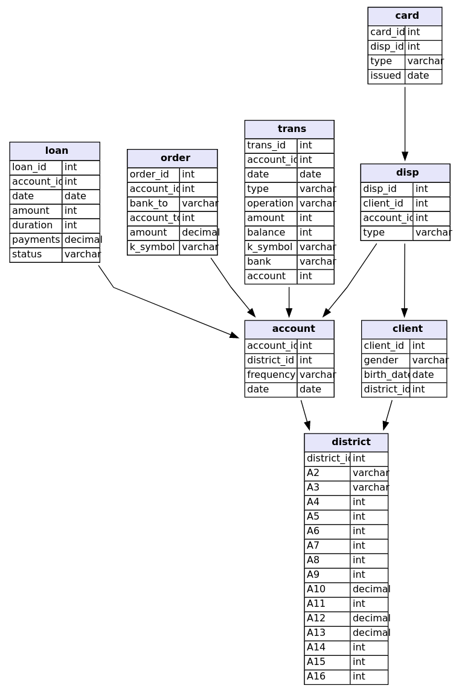
Dataset
Final Dataset
104904 Records
25 Variables
Target Variable: Loan Status

Slide 5
Loan Status is the target variable
Loan Status
'A': contract finished, no problems
'C': running contract, OK so far
'B': contract finished, loan not payed,
'D': running contract, client in debt
Reduced Loan Status
'A': No problems
'D': Client will default

Slide 6

Recall as scoring measure
How many defaults were correctly identified?
TP: Declined, Defaulted
FN: Approved, Defaulted

Slide 7
Adaptive Boosting is the winner!
Adaptive Boosting:
Recall Score:
1.000
We correctly identify every costumer that has defaulted

Slide 8
Adaptive Boosting is the winner!
Adaptive Boosting:
Recall Score:
1.000
We correctly identify every costumer that has defaulted
Other models:
Decision Tree: 0.998
Random Forest: 0.998
Gradient Boost: 0.998
XGradient Boost: 0.998
CatBoost: 0.841

Slide 9
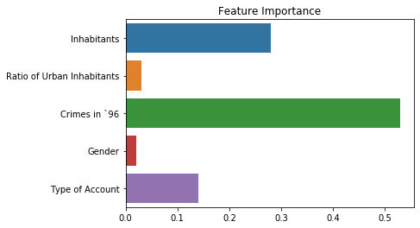
Crime rate is important

Slide 10
Summary
Adaptive Boosting model predicts 100% of clients that will default
Crime rate in ‘96 is largest determining factor
Improvements
Feature engineering (eg. Time)

